Slide 1
Chapter 20
Probability and Sampling Distribution

Slide 2
Learning Objectives
Explain how to generate random sample for an experiment
Explain how to generate random sample according to percentage or case wise
Understand the concept of probability distribution
Explain the concept of discrete probability distribution, including Binomial and Poisson probabilities
Demonstrate the steps used in SPSS to execute Binomial and Poisson probability distributions
Display Binomial and Poisson distribution graphically

Slide 3
Explain the concept of normal density function for continuous random variables
Demonstrate the steps used in SPSS to execute normal probabilities for normal distributed variables
Explain the concept of sampling distribution
Demonstrate the simulation of desired sample through SPSS Syntax programming language
Use SPSS in simulating a data set
Describe the shape and statistics of sampling distribution derived from simulated data

Slide 4
Introduction
The random sample can be generated either for a particular experiment or in the existing population elements.
The chapter also highlights the probability distributions and sampling distribution. The probability distributions are manifested by mathematical functions, indicating the probabilities of occurrence of all possible outcomes in a particular experiment.
The probability distributions are categorized into discrete and continuous based on the nature of the random variable as incorporated in the analysis.
The chapter also focuses on the application of sampling distribution in order to make inferences about unknown population parameters.

Slide 5
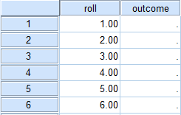
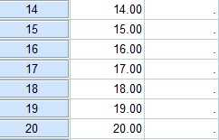
Generating a Random Sample
Generating Random Sample for an Experiment
Generate Variables, Data and Missing Values
Exhibit 20.1. Open blank SPSS Data Editor » Create two variables: roll and outcome » Type 1 to 20 for roll in Data View » Outcome – remains empty » Consider as missing values » Save as random

Slide 6
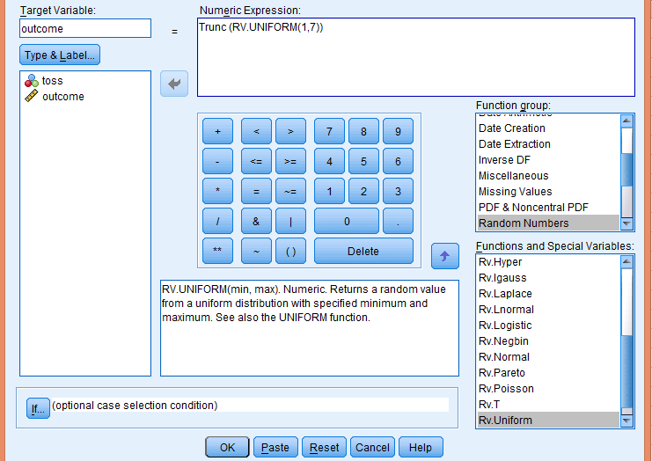
Generate Outcome
Exhibit 20.2. Use data set random » transform » compute variable » type outcome in Target variable box » select and click on Random Numbers » select RV. Uniform in Functions and Special Variables box » type 1, 7 in the numerical expression box » type Trunc in front of RV. Uniform as Trunc (RV.UNIFORM(1,7)) » press Ok » Change existing variable » press Ok

Slide 7
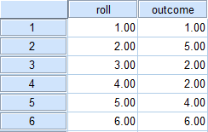
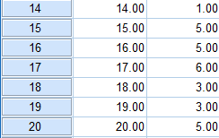
Random Number Output
Generating Random Sample Case Wise
Exhibit 20.3. Use data set retail.sav » Data » Select cases » Select random sample of cases » Click on Sample » Select exactly and type 50 and 120 in the given options » Continue » Click OK

Slide 8
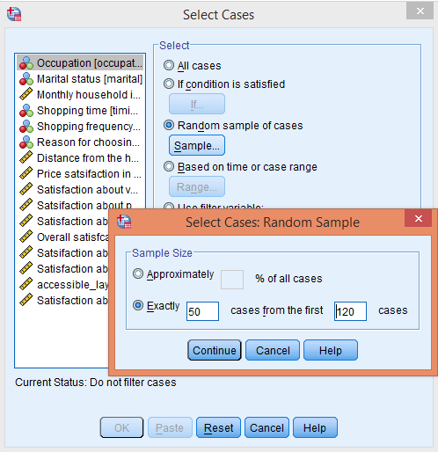
Generating Random Sample Case Wise

Slide 9
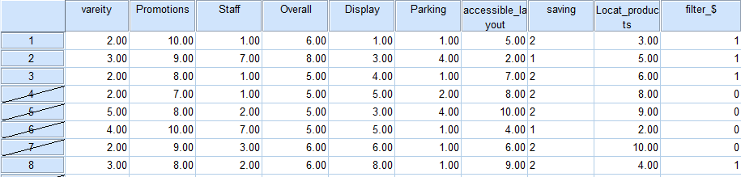
Simple Random Sample Output
At the last column, one new variable filter_$ is created by SPSS having values 0 and 1, indicating those cases that are excluded and remained in the data set, respectively. Hence, with this procedure the cases 1, 3, 7, 16, 17 … 115, 116 and 119 are included in revised data set.

Slide 10
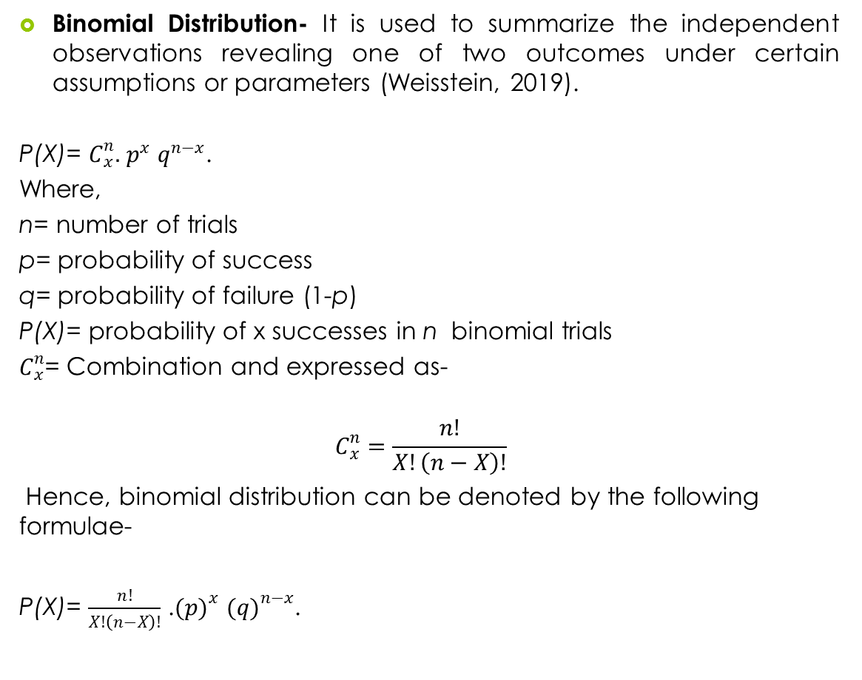
Probability Distribution

Slide 11
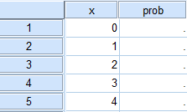
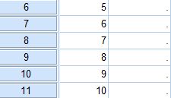
Executing Binomial Distribution with SPSS
Create Data Set in SPSS Data Editor
Exhibit 20.4. Open SPSS Data Editor » Create two variables » x and prob » Assign values 0, 1, 2, 3 … 10 for x variable » Leave blank for prob variable

Slide 12
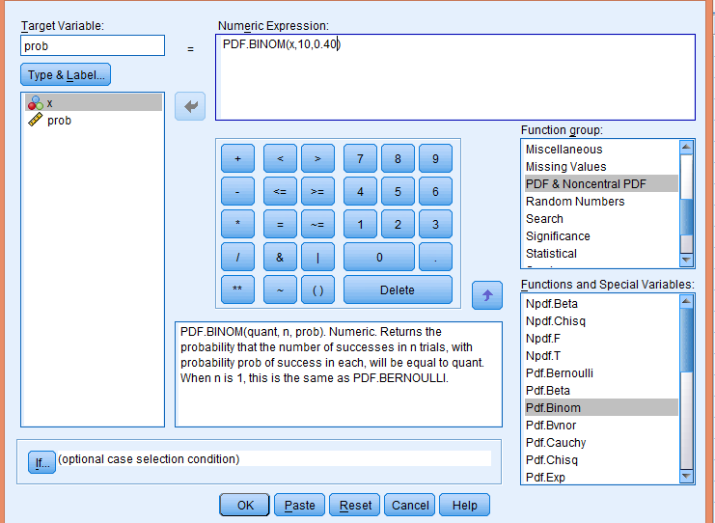
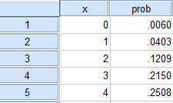
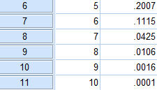
Compute Probability Density for Binomial Variable
Exhibit 20.5. Transform » Compute variable » Type prob in Target Variable box » Select and click on PDF & Noncentral PDF in Functions group » Select PDF.Binom in Functions and Special Variables Box and double click » Select x In Type & Label box and transfer into Numeric Expression box » Type 10 and 0.40 in place of ?, ? » Click OK » Change existing variable » Click OK

Slide 13
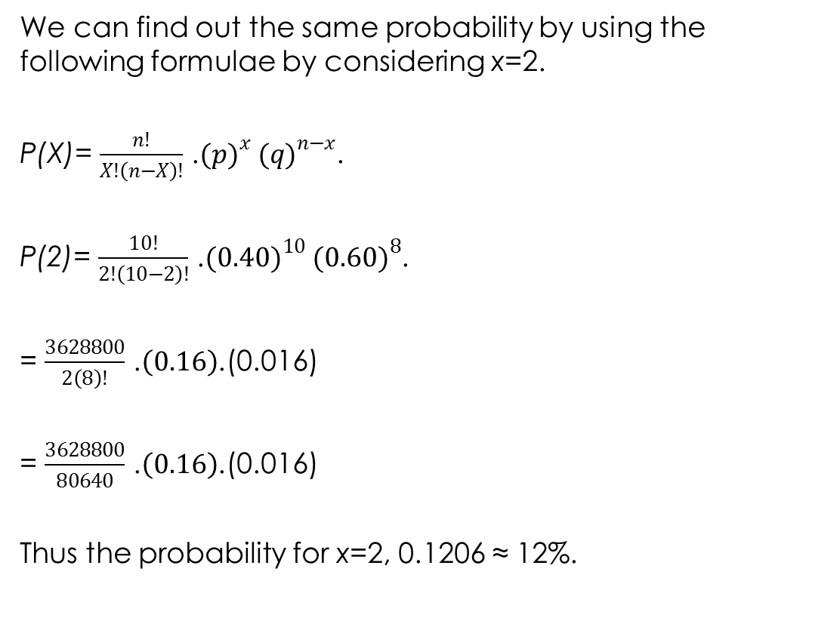
Calculations

Slide 14
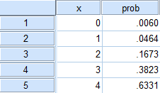
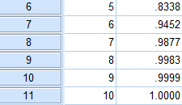
Compute Commutative Probability Density for Binomial Variable
Exhibit 20.6. Transform » compute variable » type prob in Target variable box » select and click on CDF & Noncentral CDF in Functions group » select CDF.Binom in Functions and Special Variables Box and double click » select x In Type & Label box and transfer into numeric expression box, type 10, and 0.40 in place of ?, ? » press Ok » Change existing variable » Ok

Slide 15
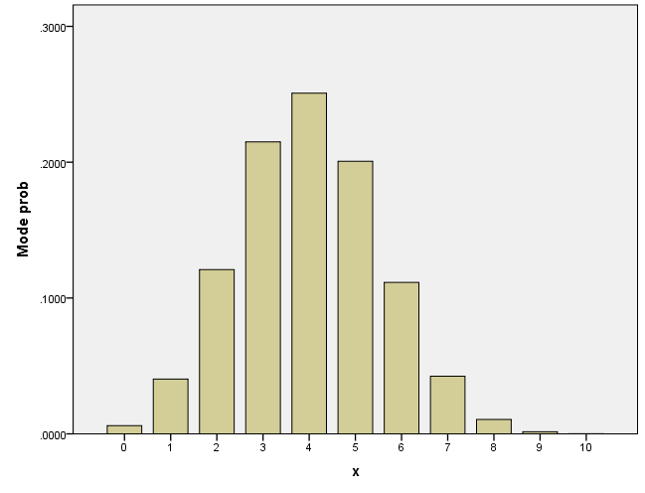
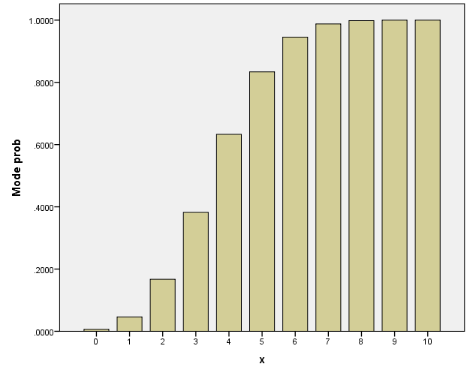
Displaying Probability Density Function and Cumulative Distribution
Figure 20.1a. Binomial Probability Density Distribution
Figure 20.1b. Cumulative Distribution: Binomial Probability

Slide 16
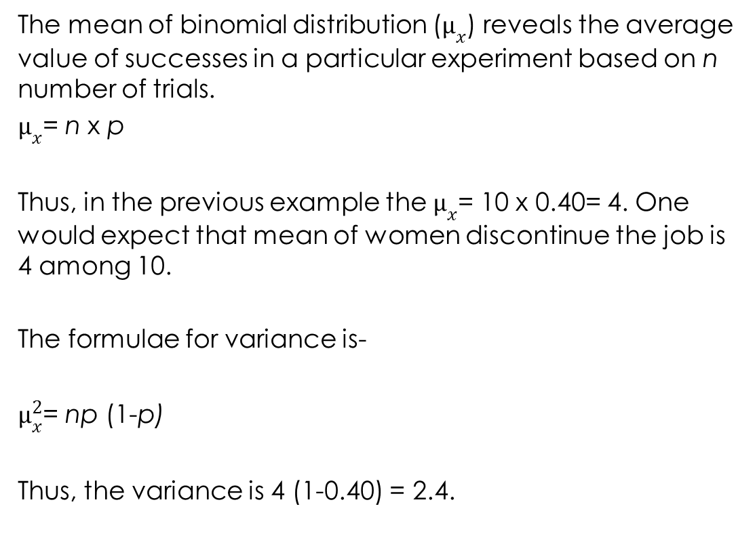
Mean and Variance of Binomial Distribution

Slide 17
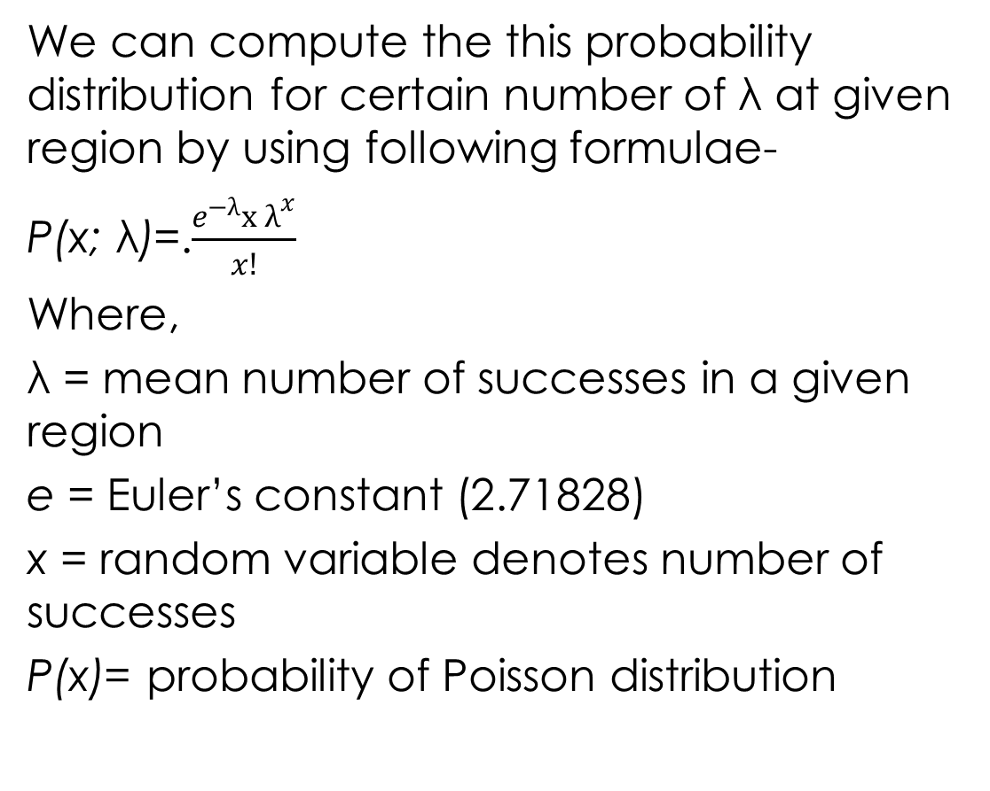
Poisson Distribution

Slide 18
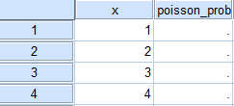
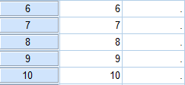
Executing Poisson Distribution with SPSS
Creating Data Set for Poisson Distribution
Exhibit 20.7. Open SPSS Data Editor » Create two variables: x and poisson_prob » Assign values 0, 1, 2, 3….. 10 for x variable » Leave blank for poisson_prob variable

Slide 19
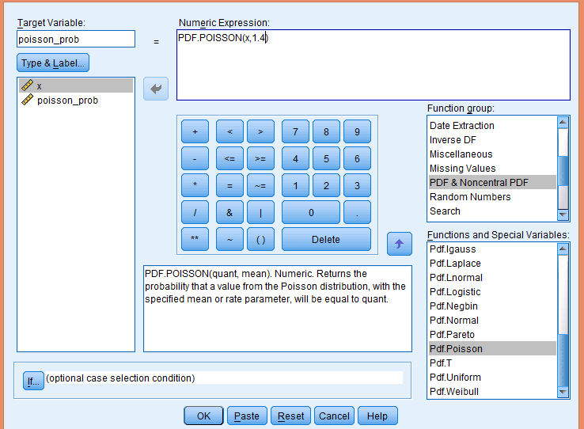
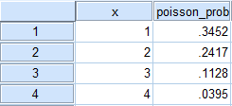
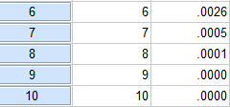
Compute Probability Density for Random Variable
Exhibit 20.8. Transform » compute variable » type poisson_prob in Target variable box » select and click on PDF & Noncentral PDF in Functions group » select PDF.Poisson in Functions and Special Variables Box and double click » select x In Type & Label box and transfer into numeric expression box, type 1.4 in place of ?, ? » press Ok » Change existing variable » Ok

Slide 20
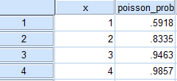
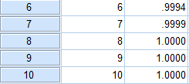
Compute Commutative Probability
Exhibit 20.9. Transform » compute variable » type prob in Target variable box » select and click on CDF & Noncentral CDF in Functions group » select CDF.Poisson in Functions and Special Variables Box and double click » select x In Type & Label box and transferred into numeric expression box, type 1.4 in place of ?, ? » press Ok » Change existing variable » Ok

Slide 21
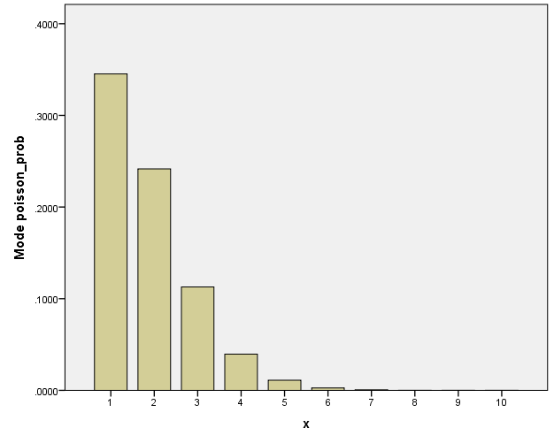
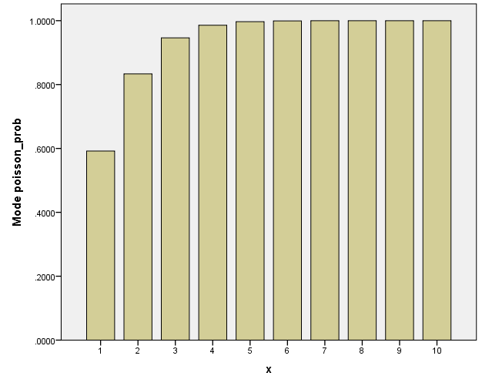
Displaying Probability Density Function and Cumulative Distribution
Figure 20.2a. Probability Density: Poisson
Figure 20.2b. Cumulative Distribution: Poisson

Slide 22
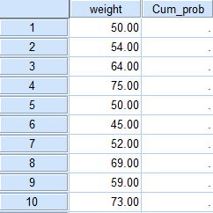
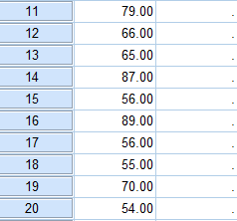
Computing Normal Probabilities
Creating Data Set for Normal Density Function
Exhibit 20.10. Open SPSS Data Editor » Create two variables » weight and cum_prob » Assign values of weight in first column » Leave blank for cum_prob variable

Slide 23
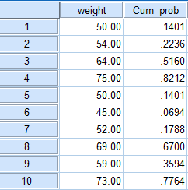
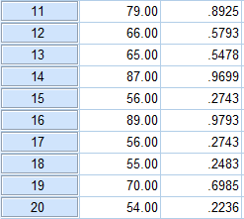
Computing Probability Under the Curve
Exhibit 20.11. Transform » compute variable » type cum_prob in Target variable box » select and click on CDF & Noncentral CDF in Functions group » select CDF.Normal in Functions and Special Variables Box and double click » select weight In Type & Label box and transfer into numeric expression box, type 63.4 and 12.5 in place of ?, ? » press Ok » Change existing variable » Ok

Slide 24
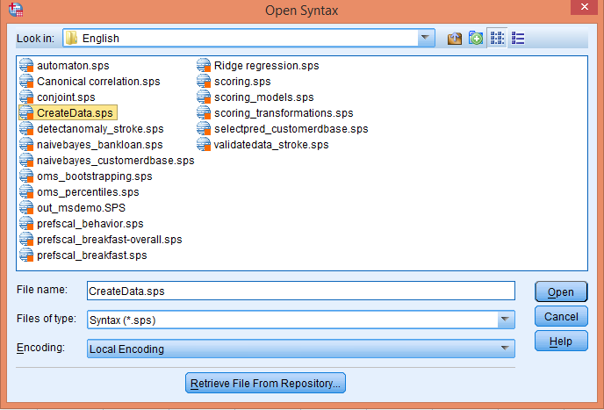
Sampling Distribution
Simulating Sampling from SPSS
Exhibit 20.12. Open blank SPSS Data Editor » file » open » syntax » open syntax dialog box » select Syntax (*.sps) as file type » select Local C drive » Program files (x86) » IBM » SPSS » Statistics » 22 » samples » English » click Createdata.sps » open

Slide 25
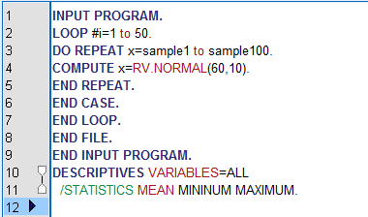
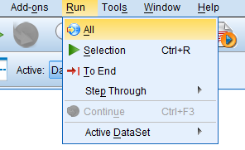


Syntax Editor
Exhibit 20.13. INPUT PROGRAM » type 1 to 50 for LOOP #i » type sample1 to sample100 for DO REPEAT x » type (60,10) for COMPUTE x=RV.NORMAL » go to menu bar » run » click All

Slide 26
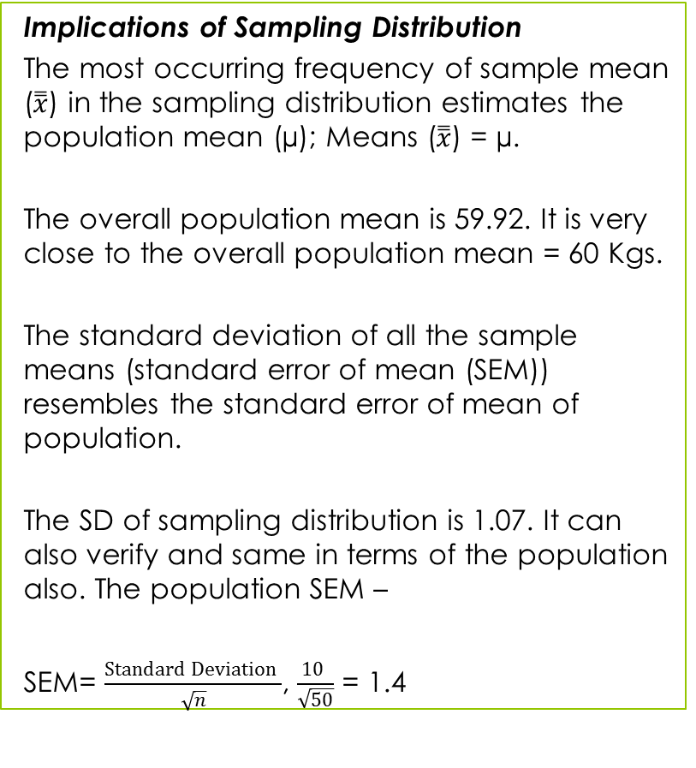
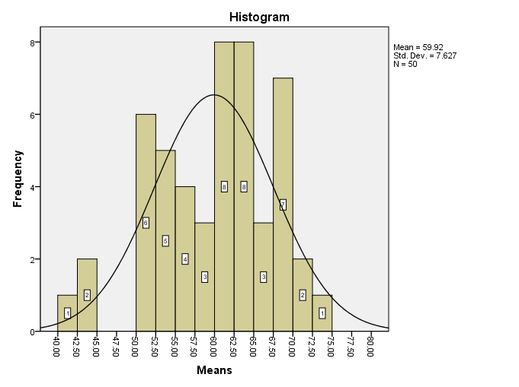
Sampling Distribution of Means­

Slide 27
Key Terms
Binomial distribution Central limit theorem Commutative probability Normal density function Normal distribution Poisson distributions | Random variable Sampling distribution­ Simulation SPSS Syntax Standard error of mean

